Slide 1
État des lieux - traduction du nouvel ENA
Février 2015
Préparé par Magali Bourquin (MBN)

Slide 2
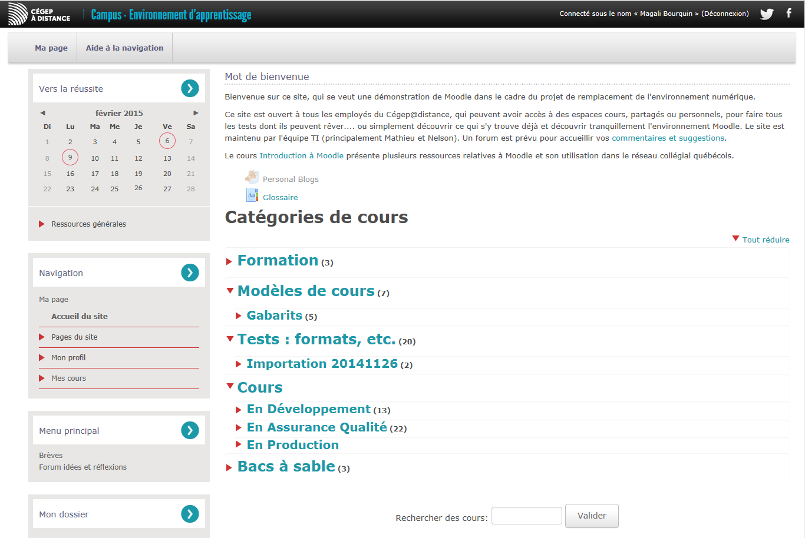
Welcome to your learning environment!
We hope that your experience will be pleasing and motivating.
Note that you can come back to your course listing at any time by clicking on My Page.
Supprimer

Slide 3
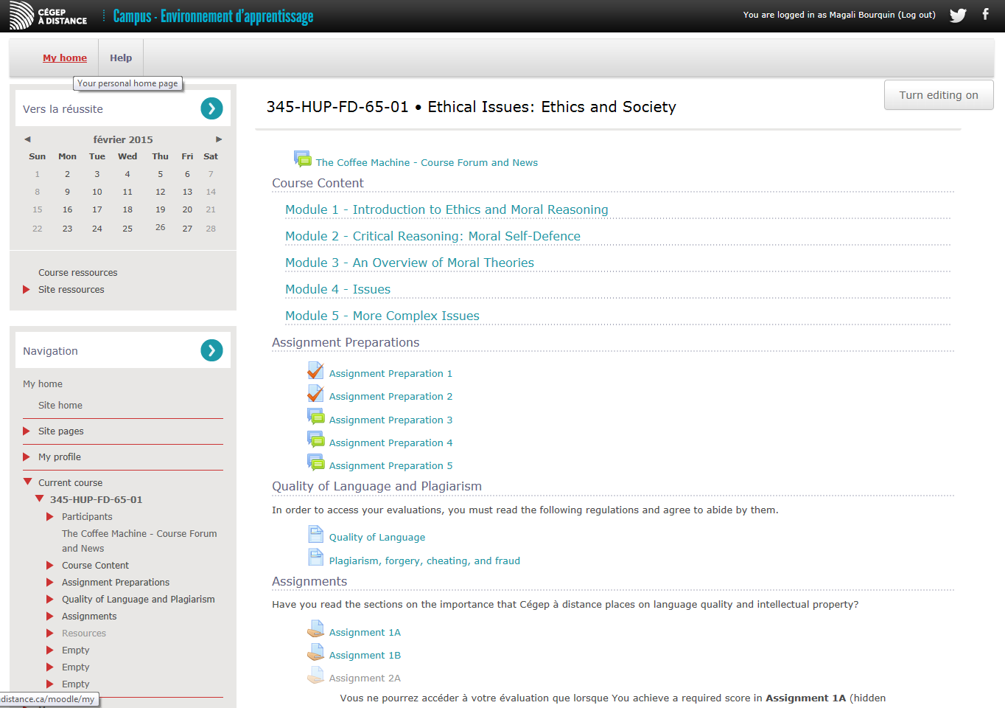
My Page
1
Navigation Help
Julien
Toward Success
Welcome to this Course
In this space you will find lots of learning resources that will contribute to your success and help you achieve your objectives.
Before you begin, to be sure you don’t miss anything, we suggest that you explore this page and all the resources and tools on it.
Go ahead and get started!
Welcome to this Course (cours imprimés)
In this space, you can view your grades and helpful resources to your learning process.
Julien
General Resources
Course bulletin board
Vous ne pouvez accéder à votre évaluation que si vous avez obtenu une note dans
Notes:
1. MBN – le matériel de cours a été adapté en insérant cette formule (voir document maitre)

Slide 4
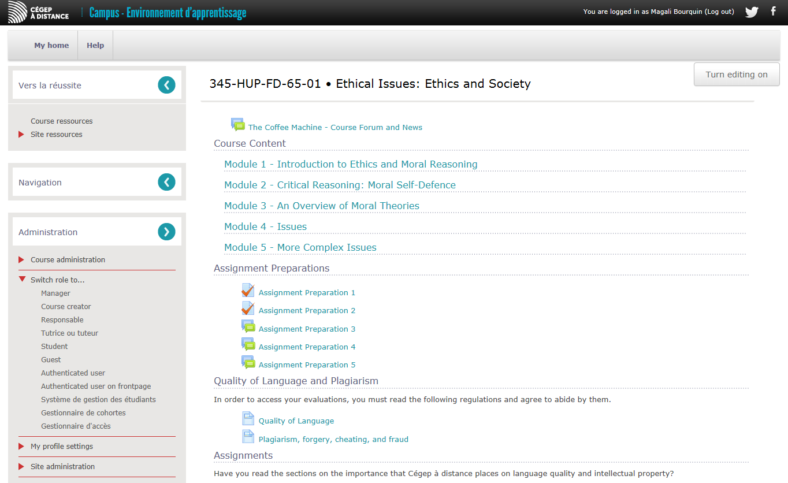
Tutor

Slide 5
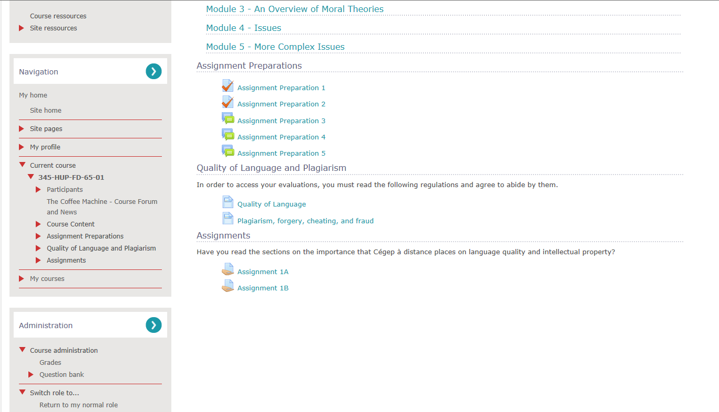
My results

Slide 6
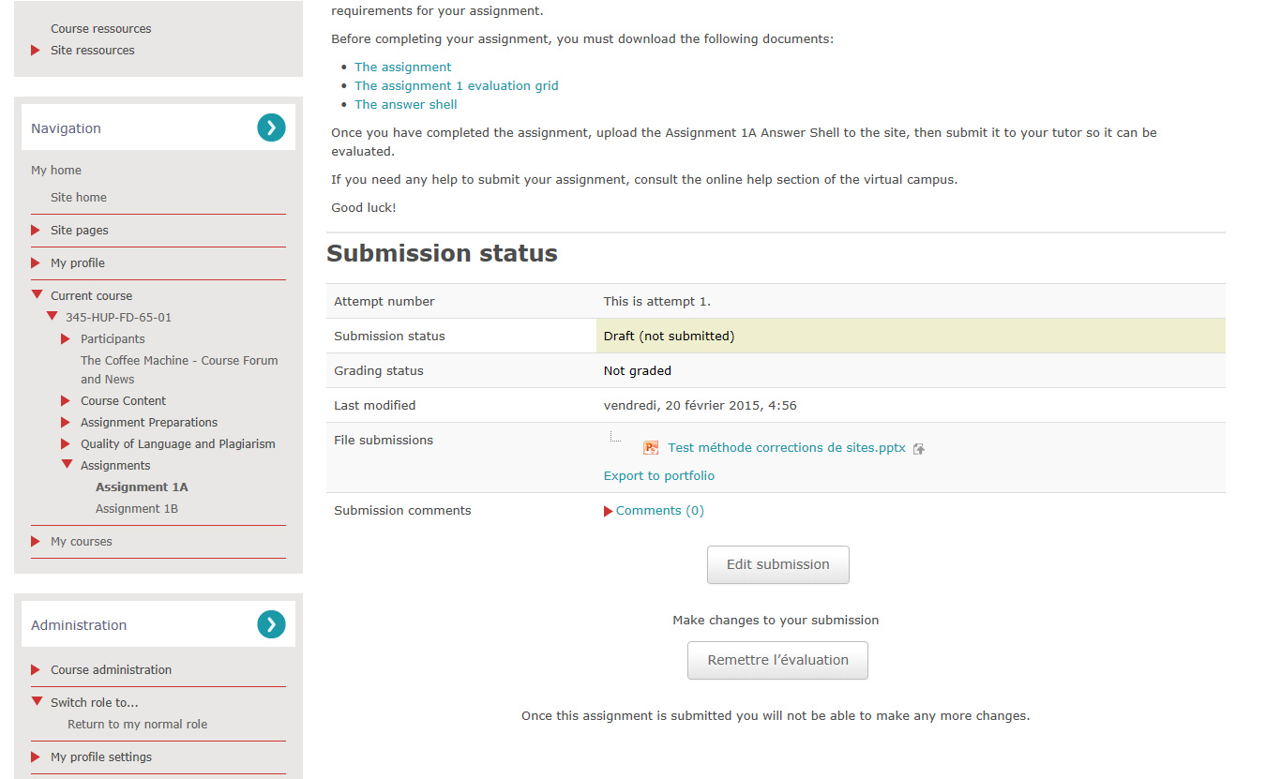
Submit the evaluation

