Slide 1
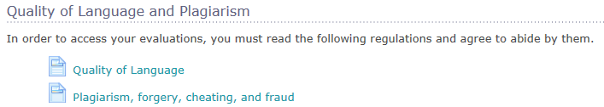
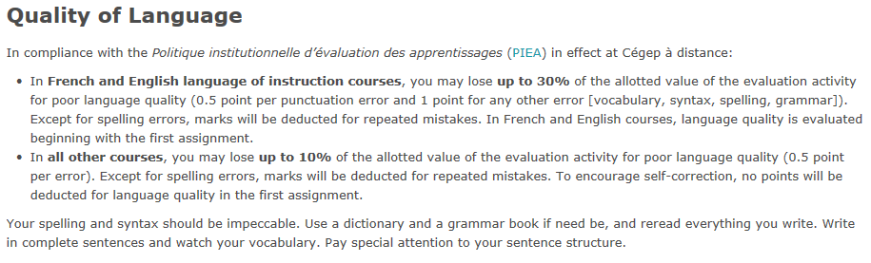
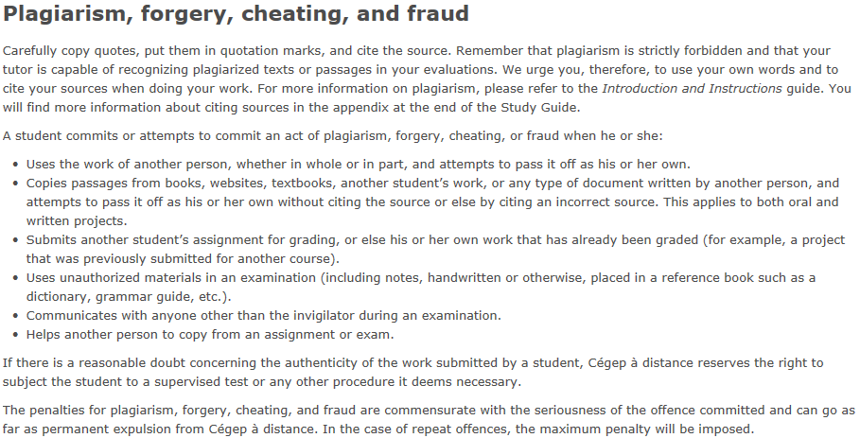
Language Quality
In compliance with the Politique institutionnelle d’évaluation des apprentissages (PIEA) in effect at Cégep à distance:
In French and English language of instruction courses, you may lose up to 30% of the allotted value of the evaluation activity for poor language quality, at 0.5 point per punctuation error and 1 point for any other error (vocabulary, syntax, spelling, grammar). Except for spelling errors, marks will be deducted for repeated mistakes. In French and English language of instruction courses, language quality is evaluated beginning with the first assignment.
In all other courses, you may lose up to 10% of the allotted value of the evaluation activity for poor language quality (0.5 point per error). Except for spelling errors, marks will be deducted for repeated mistakes. To encourage self-correction, no points will be deducted for language quality in the first assignment.
Your spelling and syntax should be impeccable. Use a dictionary and a grammar book if need be, and reread everything you write. Write in complete sentences and watch your vocabulary. Pay special attention to your sentence structure.
Plagiarism, forgery, cheating, and fraud
Carefully copy quotes, put them in quotation marks, and cite the source. Remember that plagiarism is strictly forbidden and that your tutor is capable of recognizing plagiarized texts or passages in your evaluations. We urge you, therefore, to use your own words and to cite your sources when doing your work. For more information on plagiarism, please refer to the Introduction and Instructions guide. You will find more information about citing sources in the appendix at the end of the Study Guide.
A student commits or attempts to commit an act of plagiarism, forgery, cheating, or fraud when he or she:
Uses the work of another person, whether in whole or in part, and attempts to pass it off as his or her own.
Copies passages from books, websites, textbooks, another student’s work, or any type of document written by another person, and attempts to pass it off as his or her own without citing the source or else by citing an incorrect source. This applies to both oral and written projects.
Submits another student’s assignment for grading, or else his or her own work that has already been graded (for example, a project that was previously submitted for another course).
Uses unauthorized materials (including notes, handwritten or otherwise, placed in a reference book such as a dictionary, grammar guide, etc.).
Communicates with anyone other than the invigilator during a final evaluation.
Helps another person to copy from an assignment or a final evaluation.
If there is a reasonable doubt about the authenticity of the work submitted by a student, Cégep à distance reserves the right to subject the student to a supervised test or any other procedure it deems necessary.
The penalties for plagiarism, forgery, cheating, and fraud are commensurate with the seriousness of the offence committed and can go as far as permanent expulsion from Cégep à distance. In the case of repeat offences, the maximum penalty will be imposed.

